Slide 1

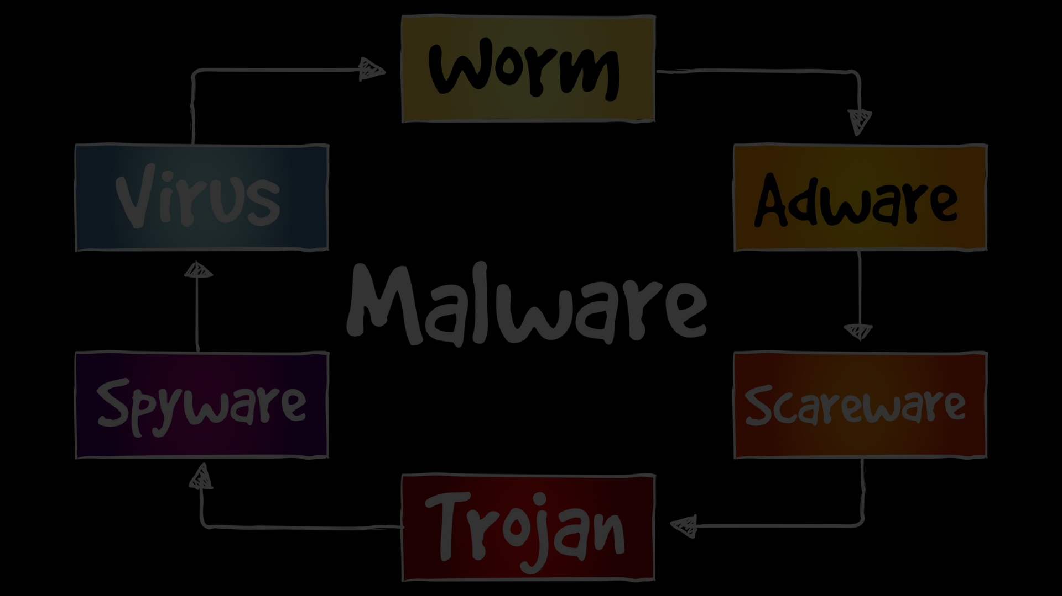

ANTiVirus
Protect your device from malicious app threats with our comprehensive solutions. Learn about different types of malicious apps, how they impact your device, and ways to prevent them from infecting your system.

Slide 2
Introduction to the Problem
As technology advances, so do the threats. Discover how malicious app viruses can infiltrate your device, compromising your data and privacy. Stay one step ahead by understanding the dangers lurking online.

Slide 3

Types of Malicious Apps and Their Impact
Explore the various types of malicious apps, from ransomware to spyware, and the devastating effects they can have on your device. Discover how these digital pests can corrupt files, steal personal information, and disrupt your digital life.
Some of the most common types of malicious apps include adware, Trojan horses, and phishing apps. These can lead to slow performance of your device, pop-up ads, and can capture your personal data without your knowing. It is important to know how to protect yourself from such vulnerabilities.

Slide 4

Common Ways Malicious Apps Spread to Devices
Uncover the tactics used by hackers to distribute viruses and infiltrate devices. From malicious email attachments to infected websites, be aware of the common traps and learn how to avoid falling victim to these cunning schemes.
Malicious apps can also be disguised as a legitimate app and can be downloaded from third-party app stores or links sent through text messages. These apps may ask for excessive permissions, which can compromise your data and device. Always download apps from trusted sources and carefully read app permissions.
Another common way that malicious apps spread to devices is through social engineering techniques. Hackers may trick users into clicking on fake download links or advertisements, leading them to unknowingly install malware. It is crucial to exercise caution when browsing the internet and avoid clicking on suspicious links or ads.
Additionally, some malicious apps may be strategically placed in legitimate app stores, disguising themselves as reputable apps. Always research an app before downloading and read user reviews to identify any potential red flags. Taking these proactive measures can help protect your device from the infiltration of malicious apps.

Slide 5

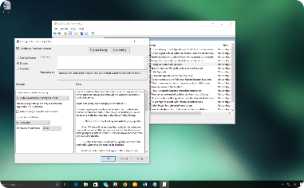

Techniques for Preventing Malicious Application Installation.
Enhance Your Firewall
Keep Your System Updated
Download from Trusted Sources
Fortify your device's defenses with a strong firewall to block unauthorized access and prevent virus installation.
Regularly update your operating system and software to patch vulnerabilities and stay protected against the latest threats.
Only download software and apps from reliable sources to minimize the risk of installing infected files onto your device.

Slide 6

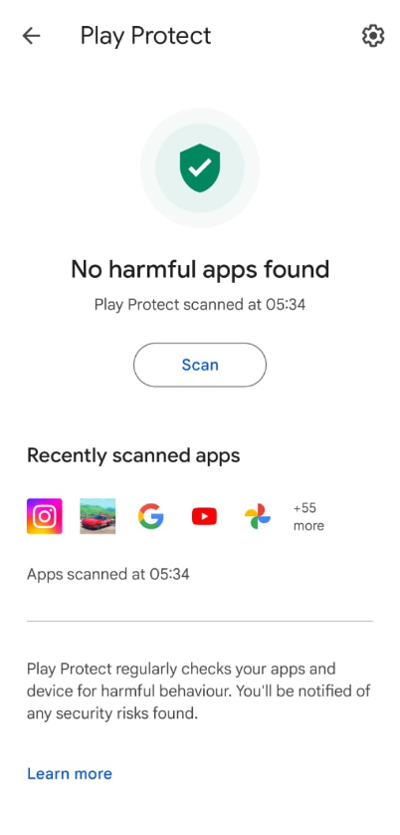
In-Built Google Play Protect
Discover the powerful security features offered by Google Play Protect. Learn how it scans and verifies apps for malware, ensuring the safety and integrity of the apps you download from the Google Play Store.
With Google Play Protect, your device is protected by continuous scanning and verification of apps, minimizing the risk of downloading malware from the Google Play Store. This built-in security feature offers peace of mind when it comes to the safety and integrity of the apps you use on your device. Stay one step ahead of potential threats by utilizing Google Play Protect.
By enabling Google Play Protect, you can also benefit from its ability to locate, lock, or erase your device in case of loss or theft. Additionally, it automatically scans any apps installed from third-party sources for potential threats. Take advantage of Google Play Protect's comprehensive security measures to keep your device and personal information safe.

Slide 7

Best Practices for Safe Web Browsing
Learn essential tips and tricks for a secure online browsing experience. From using secure connections to avoiding suspicious websites, empower yourself with the knowledge to browse the internet safely.
Stay updated with the latest browser updates and security patches to ensure that your browser is equipped with the latest protection against vulnerabilities. Additionally, regularly clear your browsing history, cookies, and cache to minimize the risk of storing sensitive information. Finally, be cautious of clicking on suspicious links or downloading files from unknown sources to avoid potential malware infections.

Slide 8

Conclusion and Additional Resources
Wrap up your journey to becoming a vigilant protector of your digital life. Find additional resources, such as blogs, forums, and guides, to further expand your knowledge and stay ahead of ever-evolving cyber threats.

Slide 9

Contact Information
If you have any questions or concerns, feel free to contact our dedicated team of experts. We're here to help you strengthen your digital defenses and keep your device safe from viruses.
Email: info@zappin.com
Phone: 9933241XXX

